Slide 1
Software defined networks
Luca Scalzotto

Slide 2
Traditional networks
Control Plane
Communicates with other nodes in the network by running distributed protocols (e.g. BGP) in order to determine how individual packet types should be handled
Pushes this information down to the Data Plane
Data Plane
Creates the forwarding table (aka Forwarding Information Base, FIB) based on the information received from the controller
Handles incoming datagrams performing lookups in the forwarding table
If a forwarding rule exists the packet is sent to the correspondent output network interface to physically perform the forwarding
Otherwise the Control Plane is previously addressed in order to determine the packet’s destination

Slide 3
Traditional networks
Control Plane and Data Plane are contained within a single physical system
Switches are proprietary locked boxes
Control Plane and Data Plane are chained together
There is no direct access into the behavior of the Data Plane
Operators can configure the switches only through the Control Plane
if a new network behavior is required options can be limited
Each node has to be configured individually
Distributed protocol in order to communicate - complex!

Slide 4
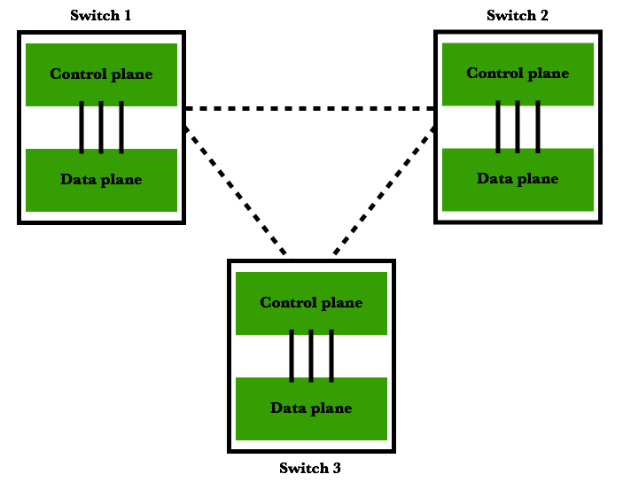
Traditional networks

Slide 5
Software defined networks (SDN)
Characteristics of SDN:
Centralized controller with a global view of the entire network
Single point of configuration - ease of management
Open & Programmable
New applications that modify the default network behavior can be created
SDN applications:
Traffic engineering in order to optimize the network behavior
QoS differentiation
Experimentation with new networks and new routing protocols
Load balancing

Slide 6
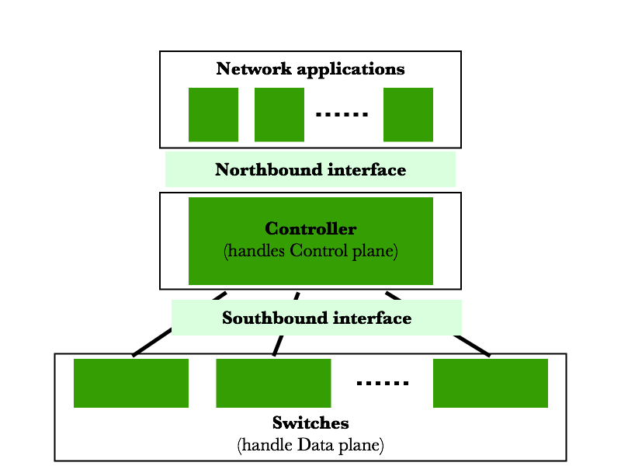
Software defined networks (SDN)

Slide 7
Software defined networks (SDN)
Software defined networks architecture components
Switches (aka network forwarding devices)
Handle the Data Plane
Hardware switches - higher performance
Software switches - greater flexibility
Southbound interface
Provides a way to enable communication between Controller and Switches
Types of information: packet handling instructions, alerts of packet arrivals on network nodes, notifications of status changes (e.g. links going up or down), providing statistics information (e.g. flow counters)
Most widespread protocol: OpenFlow

Slide 8
Software defined networks (SDN)
Controller (aka network operating system)
Handles the Control Plane
Core services to manage the network
Topology service
Statistic service
Provides a programmable interface to the network applications
Northbound interface
RESTful interface which allows the use of standard HTTP calls directed toward the controller to control network behavior and gather information collected by core services
Network applications

Slide 9
OpenFlow
Key protocol for SDN networks
Provides a way to control the behavior of switches throughout the network dynamically and programmatically
Main messages:
Packet-IN - message sent from the switch to the controller asking to determine the destination of received packets
Packet-OUT - message sent from the controller to the switch, it contains the physical output interface through which the packet has to be sent by the switch
FlowMod - message sent from the controller to the switch, it instructs the switch to add a new forwarding entry in the FIB
Timeouts for entries expiration (idle timeout, hard timeout)

Slide 10
Physically vs. Logically Centralized Controller
Physically Centralized Controller
Single point of configuration - ease of management
Low scalability and not fault tolerant
Logically Centralized Controller
Single point of configuration - ease of management
High scalability and fault tolerant
Techniques: clustering, separation in regions (east/west protocol), hierarchy

Slide 11
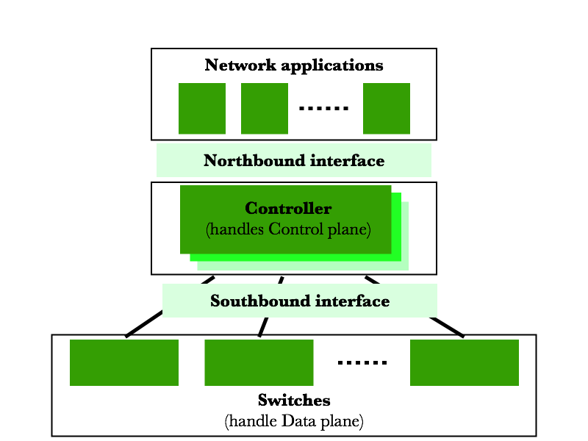
Logically Centralized Controller

Slide 12
ONOS
ONOS (Open Network Operating System) is an open source platform for developing SDN solutions
It is designed as a modular and extensible entity
Allow applications to configure and control the network without becoming dependent on device specifics
Allow developers to dynamically extend the base capabilities in order to support a big variety of use-cases
Therefore, ONOS can act as the brain for SDN networks, so it can be compared to the controller (logically centralized) for SDN networks

Slide 13
ONOS characteristics
High-availability, scalability, performance
It is designed as a distributed system
It provides logically centralized view even if it is physically distributed
Each ONOS node has the same functionalities of the other - symmetric cluster
It is dynamically scalable to be able to respond to changing workload
Communication uses TCP channels
ONOS also provides a lot of solution to enable interaction and configuration of the platform itself: GUI (real-time updating of the network topology), REST API (potentially integration with other controllers) and Command Line

Slide 14
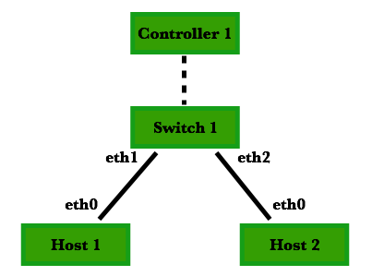
Mininet
Tool that allow to simply virtualize physical networks
It uses widely the OpenFlow protocol to modify the configuration of the network
Also provides easy to use Python API for network creation and experimentation
ONOS integration
Main node types:
Controller (handles Control plane)
Switch (handles Data plane)
Host

